Slide 1
Student Grade Calculator system
(teacher POV)
BSIT – 1A
Prince Kervin Medina
John Paul Garay
Richard Apalla
Clark Rafael
Justine Miguel
Yurry Cogay
Angelo Montano
Pearl Ayes

Slide 2
What your program does?
A C++ program designed for teachers to manage student grades.
Purpose: Store records, compute averages, and generate reports.
Real-world use: Academic grading and evaluation systems.

Slide 3
Features implemented
Add and manage student records
• Enter and validate grades
• Compute averages automatically
• Generate pass/fail and Dean’s List reports
• Secure admin login system

Slide 4
Concept integration
This project demonstrates the practical application of fundamental C++ programming concepts through the development of a Student Grade Calculator System. The program integrates control structures, functions, and input/output operations to efficiently manage student records, process grades, and generate academic reports. These concepts work together to create a structured, modular, and user-friendly system suitable for real-world academic use.

Slide 5
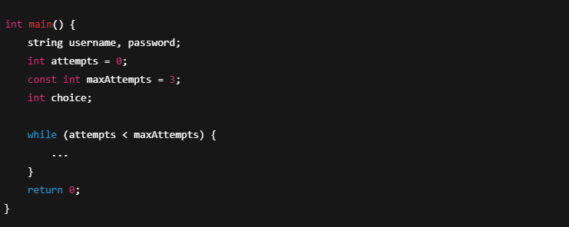
1. Basic Program Structure

Slide 6
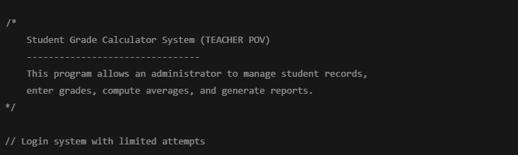
2. Comments

Slide 7
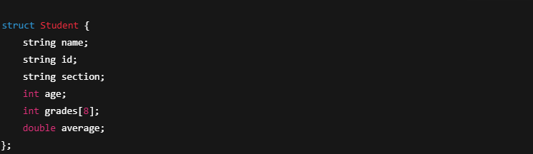
3. Identifiers, Variables, and Data Types

Slide 8
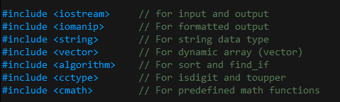
4. Preprocessor Directives

Slide 9
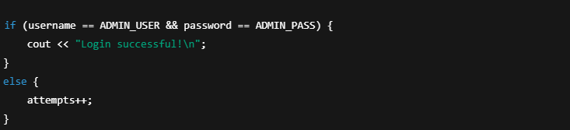
5. If Statements (Selection Structure)

Slide 10
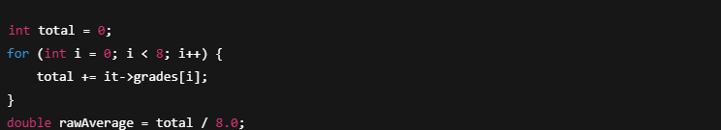
6. Arithmetic & Logical Operators

Slide 11
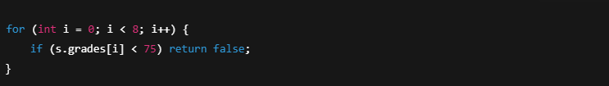
7. Loops (Repetition Structure)

Slide 12
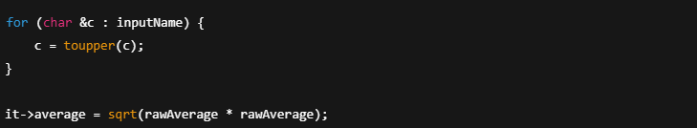
8. Predefined Functions

Slide 13
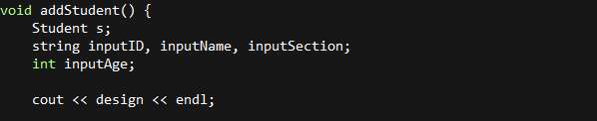
9. User-Defined Functions

Slide 14
Summary & Reflection
Through the development of the Student Grade Calculator System, our group was able to apply fundamental concepts of C++ programming in a practical and collaborative way. Working together allowed us to better understand proper program structure, the use of control structures, and the importance of organizing code using user-defined functions, structures, and vectors. This project helped us see how programming concepts can be combined to create a functional system that solves real-world academic problems.
One of the main challenges our group encountered was ensuring accurate input validation and managing student data correctly. We worked together to handle errors related to user input, grade computation, and program flow. Debugging the system and integrating different parts of the code required teamwork, clear communication, and careful testing to ensure that all features worked as intended.
For future improvements, our group plans to enhance the system by adding file handling so that student records can be saved and retrieved automatically. We also aim to improve the user experience by developing a graphical user interface (GUI) and adding more advanced features such as data analytics, customizable subjects, and role-based access. Overall, this project strengthened our programming skills, problem-solving abilities, and teamwork.

